Slide 1
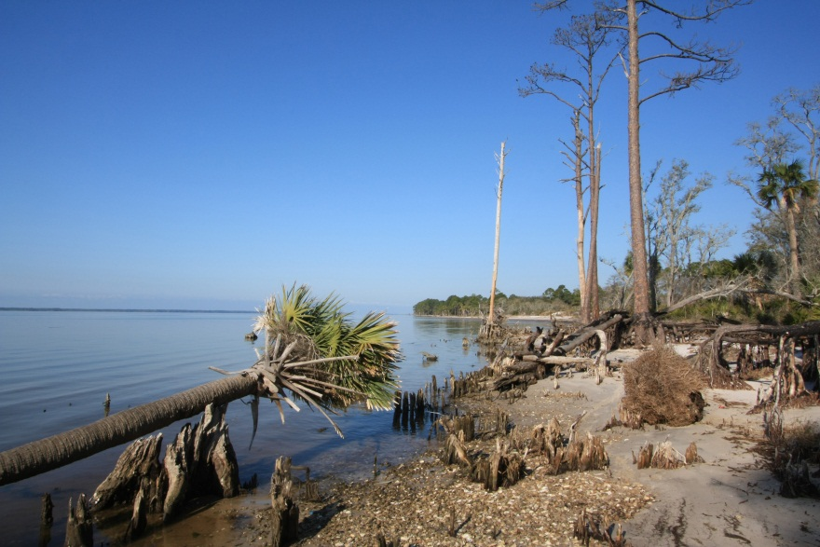
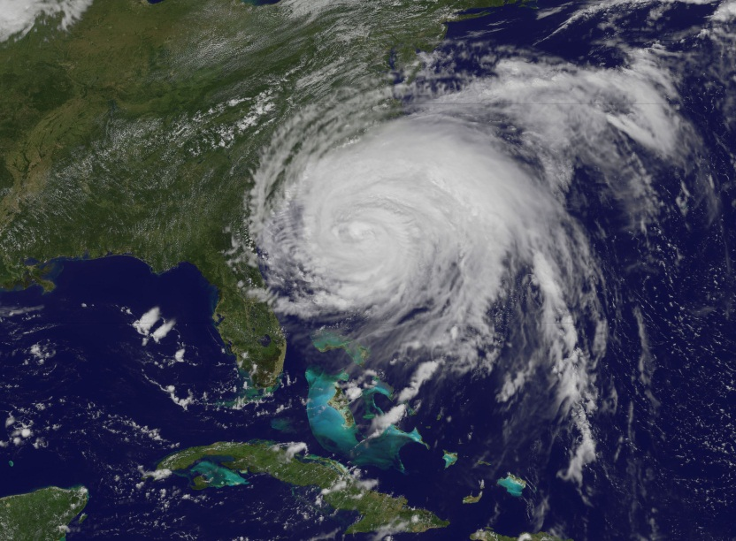
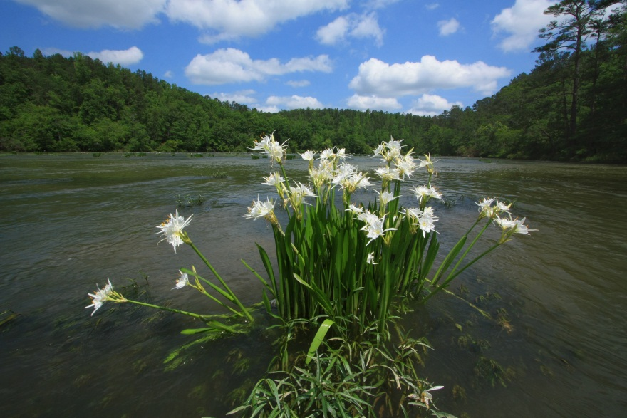
SECSC FY13/14 Science Planning: Issues and considerations in implementing a decision-oriented project portfolio
Jerry McMahon
FFACCTs
June 7, 2013
U.S. Department of the Interior
U.S. Geological Survey

Slide 2
Vision for science that “adds up”
The SECSC wants to produce actionable science that helps stakeholders in the SE understand and adapt to global change.
Today:
  Context for actionable science: formidable/wicked
    What’s the problem?
    What do we want to know?
    So what?
    Is technical information enough?
  SECSC pre FY13
  SECSC FY13 and beyond
Notes:
The topics I’ll be talking about today largely involve issues realted to answering the question of what is the niche of the SECSC, or place of emphasis, in terms of developing actionable science.
In addressing that question it is worth looking at the context for actionable science and what the SECSC has done to date.
The context involves some formidable challenges associated with answering these questions shown on the slide.

Slide 3
The SECSC wants to produce actionable science that helps stakeholders in the SE understand and adapt to global change: stakeholders and problem definition
Who are the stakeholders for SECSC science? Is it possible to row in the same direction?
  LCCs: primarily (but not entirely) conservation decisionmakers; feds, states, NGOs, others; variety across LCCs in terms of maturity of problem definition.
  Working landscape interests: private landowners, companies, etc; vary in size of operation and perspective; wide variety of interests
  Politicians
  Scientists: Many disciplines; variety of science cultures (academia, NGO, gov’t); general strong desire to collaborate or explore collaboration, but barriers exist.
    Human nature…
Notes:
To produce actionable science we have to be aware of the needs, interests, and how global change problems are perceived by the variety of parties whose decisions are shaping the landscape in the SE.
I think it is safe to say that the many and sometimes disparate points of view and priorities can make it challenging to define global change adaptation problems, and associated information needs, in a way that everyone is ready to row in the same direction.

Slide 4
The SECSC wants to produce actionable science that helps stakeholders in the SE understand and adapt to global change: science challenges (part I)
What do we want to know (knowledge production culture)?
  Tension (sometimes) between curiosity driven and more applied science/research
  Tension(sometimes) between furthering a research program and responding to research opportunities that may intersect with program in only a tangential way.
  Complex, interacting, dynamic (space & time), couple human-natural systems that need to be understood at multiple scales to account for impacts of global change processes on much more local concerns and decisions.
    Research may need to be interdisciplinary, have qualitative and quantitative elements, cross scales
Notes:
The practice of science, of course, is a key element in defining what we know about these global change problems.
In producing actionable knowledge there are at least two challenges, involving the production and the consumption of this knowledge.
For the scientist, and maybe especially for the science manager, there are several tensions that can influence the science that gets done…
Regardless of how these tensions are resolved, the reality is that considering the global change processes as a whole, the science that needs to be done is difficult, for the reasons shown on the slide.

Slide 5
The SECSC wants to produce actionable science that helps stakeholders in the SE understand and adapt to global change: science challenges (part 2)
What do we want to know (knowledge consumer culture)?
  Understanding, among such a broad group of stakeholders, requires some general education
    What is global change? How is it manifest? Why does it matter? (NC Nature Research Center as example)
  Science-based understanding should lead to the ability to connect policy actions with endpoints that matter to stakeholders, and an ability to assess the relative merit of different proposed actions (which requires making trade-offs among the endpoints)
  Human nature…
Notes:
Another part of the science side of producing actionable knowledge is that we as scientists can’t count on those on the receiving end of what we produce to “get it” and use our work in their decisions.
The reality is that much of our work will enter a world of individuals and institutions that may lack even a general appreciation of what we are talking about…there is a need for what you might think of as general education, both about the variety of systems and processes we deal with and the connection between science-based information and the things that people care about. If the public in general and decisionmakers in particular can’t make a connection between our work and what they care about, they may not be inclined to recognize and value our work in their decisionmaking.
We ignore this reality at our peril, I think.

Slide 6
The SECSC wants to produce actionable science that helps stakeholders in the SE understand and adapt to global change: actionable science challenges
  Improving science and technical knowledge is no guarantee that the science will be used to make better decisions.
  The lack of a transparent, well functioning set of institutions to facilitate science-based adaptive management decisions is an ongoing challenge.
  Potential mismatch between how decisions are made and the nature of these “wicked” problems
    Thinking fast and thinking slow (Kahneman)
    Fast (intuition; heuristics; use familiar frameworks) may fall short in some ways with wicked problems.
Notes:
Several other aspects of the context of producing actionable science are worth mentioning, even if they are largely out of the control of us as scientists.
Slide stuff…
Even though many of these issue are not under our control, I think that for me as a science manager, it is worth keeping this context in mind, certainly as we are still in the process of figuring out our niche. The question in the back of my mind needs to be, are there things that the SECSC can do that can make the science we support more useful given this context?

Slide 7
The SECSC wants to produce actionable science that helps stakeholders in the SE understand and adapt to global change: SECSC pre-FY13
Stakeholder interests/problem defn: largely LCC-driven (with SECSC staff); evolution toward decision-relevant science
Science
  Understanding (general education): state of science syntheses (downscaling; communicating uncertainty; ecoflow; climate sensitive ecosystems; SLR/wetlands
  Understanding (modeling/prediction): mangrove expansion; habitat connectivity; sea turtle nesting; coral reef growth; urban warming and wildlife; SERAP
Actionable science
  Science has generally not been connected with specific decisions
Notes:
I think it is fair to say, at least on the CSC side of the DOI climate change enterprise, that we are still in the learning mode in terms of recognizing and understanding these challenges and operating effectively in the face of these challenges.
Slide…

Slide 8
The SECSC wants to produce actionable science that helps stakeholders in the SE understand and adapt to global change: critique of SECSC pre-FY13 science
Generally no explicit coupled human-natural system conceptual framework used in investigations.
Generally no explicit decision connection
Cultural challenges:
  Science side: research on coupled human-natural systems is difficult; interdisciplinary communication among scientists can be challenging; reward structure for some scientists may not foster actionable science; communications with the public can be time consuming and
  Public side: motivation and resources to think slow may be in short supply. Role/importance of “general education”?
Notes:
Given the formidable, or wicked, problems that make up the context for the SECSC activities, I think we can point out a couple of areas where we would like to evolve.
Slide…

Slide 9
The SECSC wants to produce actionable science that helps stakeholders in the SE understand and adapt to global change: SECSC FY13 (and beyond)
1. 2013 SECSC call for statements of interest
“The Southeast Climate Science Center (SECSC) is soliciting proposals for projects that support climate change-related adaptation decisions related to the planning and implementation of a Southeast Conservation Adaptation Strategy (SECAS)…. Statements of interest and proposals should show evidence of a clear linkage between proposed science and decisions that affect the sustainability of fish, wildlife, and other natural and cultural resources.”
2. New SECSC hire: Modeling and decision analysis focus
Notes:
Over the last two years there has been an emerging theme in the work the SECSC has supported that I think has been most clearly expressed in this year’s call for proposals.
And that is a emphasis on supporting work that can be clearly linked with a global change-related adaptation decision.
In FY 13 that emphasis has been evident in two areas:
This years call for statements of interest and proposal for the SECSC science funds. There is an explicit focus on doing science that can inform actual decisions. I’ll briefly discuss the results of that call in a moment.
The emphasis is also evident in in the SECSC hiring focus.
Adam…interdisciplinary link between climate science and ecological endpoints.
New hire…interviewed two final candidates last week..with emphasis on quantitative ecology and decision analysis.

Slide 10
Decision analytic approach toward actionable science
Key: formal problem deconstruction
Decision maker(s) & stakeholders
• Values/objectives
• Risk Attitudes
• Alternative Actions
1. Problem
Framing
2. Consequences
• Predictive Models
3. Identify
Preferred Action
• Optimization
• Trade-off analysis
Notes:
I want to use this slide to quickly review the three major elements in a decision analytic approach, with credit to Mitch Eaton, one of the candidates we interviewed last week.
The overall approach is one that we all are pretty familiar with whenever we face any fairly complicated decision…we try and break the problem down into several manageable parts.
In problem framing we try and figure out what needs to be paid attention to in the decision and what our options for action are.
In the consequences stage we try and figure out what the impacts of the various options are on the things that are important to us.
Finally, we identify a preferred option or portfolio of options that does the best job of addressing our priorities.

Slide 11
SECSC FY13 projects
An adaptive landscape planning and decision framework for gopher tortoise (Gopherus polyphemus) conservation
Reserve design of Everglade Headwaters NWR
Structured decision-making to facilitate multi-stakeholder coastal conservation and restoration under climate change uncertainties: case study on barrier islands of the northern Gulf of Mexico
Developing multi-model ensemble projections of ecologically relevant climate variables for PR and the US Caribbean.
Understanding conservation management decisions in the face of SLR along the US Atlantic coast.
Development of a SECAS Conservation Decision Library

Slide 12
SECSC and actionable science
SECSC, LCCs, and other partners are still learning how to do this.
The new portfolio of projects represents a substantial investment in decision focused science and we look forward to a jump in our understanding of what actionable science is and how to do it over the next 2 years.

Slide 13
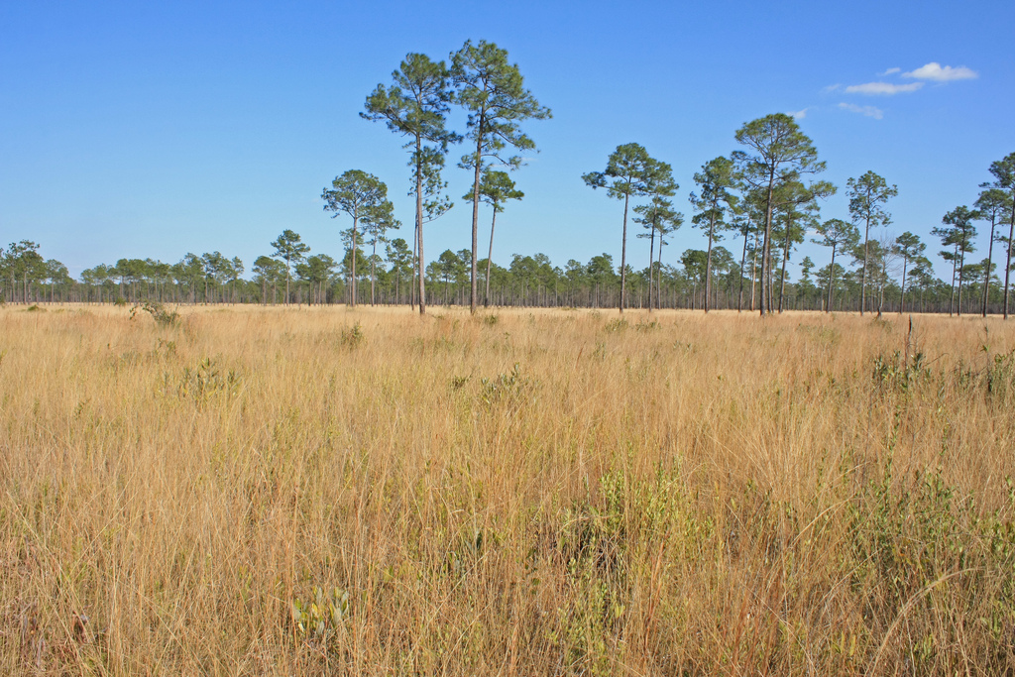
Thank you!
Jerry McMahon
gmcmahon@usgs.gov

