Slide 1
SRS Climate Change Project
Climate
Change
Adaptation and
Mitigation
Management
Options

Slide 2
Can forest management be designed to enhance the sustainability of southern forest ecosystems and their values under climate change?

Slide 3
Process
Fall 2009 SRS LT Meeting
Identification of research needs best addressed by a “cross-station”, interdisciplinary approach
CCAMMO Workshop #1 (April 2010)
Attended by SRS scientists, R8, and participants from state forestry agencies to shape outcomes & approaches and develop the research process and study plan

Slide 4
Process
Study plans, data assembly, GIS support, work begins…
Presentations to SGSF, R8 LT, Southern Leadership Tour
CCAMMO Workshop #2 (March 2011)
Attended by CCAMMO participants – update progress, focus work, explore opportunities for integration

Slide 5
FUTURES PROJECT
Climate Change Projections
Assessment of Risk & Vulnerabilities
Climate Change Adaptation
and Mitigation Management Options
CCAMMO PROJECT

Slide 6
How is this different than other recent or on-going activities?
Blate et al. 2009. Adapting to climate change in the U.S. National forests
Joyce et al. 2009. Managing for multiple resources under climate change: National forests
Baron et al. 2008. Some guidelines for helping natural resources adapt to climate change
Joyce et al. 2010. Management for adaptation
TACCIMO

Slide 7
How different?
scenario based – builds on Futures
comprehensive
Integrated (especially social science & biological sciences)
backed by data, new analyses, & peer reviewed studies
created by a team of experts

Slide 8
Organizing framework…..
eco-region specific
threats and values
vulnerability and risk
science-based, experience, models
interdisciplinary

Slide 9
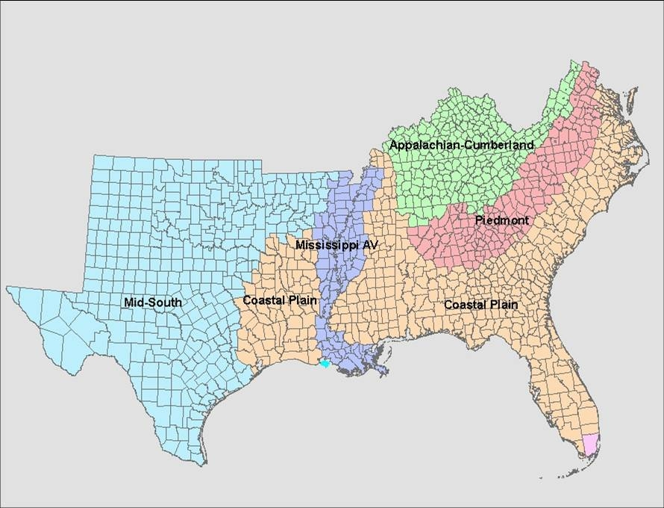
Ecoregions

Slide 10
threats and values _____________________________________________________________________ _____________________________________________________________________
threats Values
Insects, disease, invasives Timber, fiber, carbon
Wildfire Water quality & quantity
Species and habitats
Recreation
______________________________________________________________________

Slide 11
CCAMMO “Futures” Maps & Data
The maps use the same data and “cornerstone” scenarios developed for the Southern Forest Futures Project. There are four cornerstones (A,B,C, and D) that use the A1B and B2 IPCC scenarios (assumptions described on following slide), assumptions of both high and low timber prices., and three GCM’s (CSIRO, Hadley, and MIROC).
While none of the GCM’s should be viewed as producing “accurate” predictions, the MIROC produces the most extreme future climate scenarios (especially for temperature).
These maps provide a spatially explicit prediction of where changes in climate and forest cover will be greatest, and where the most substantial changes are likely to co-occur. When coupled with maps of other attributes (i.e., T&E species, water supply watersheds, WUI, etc.) these maps can be used to (1) help identify the most vulnerable areas in the south , (2) identify areas to focus “case studies”.

Slide 12
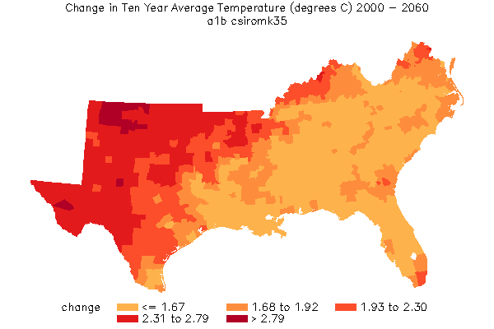
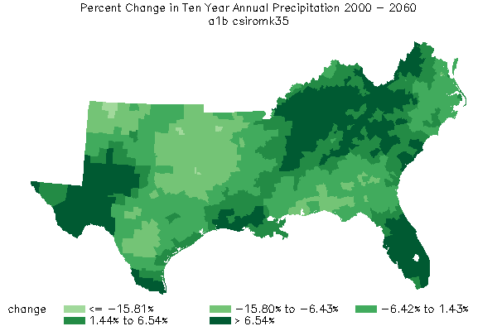
Climate Change Scenarios

Slide 13
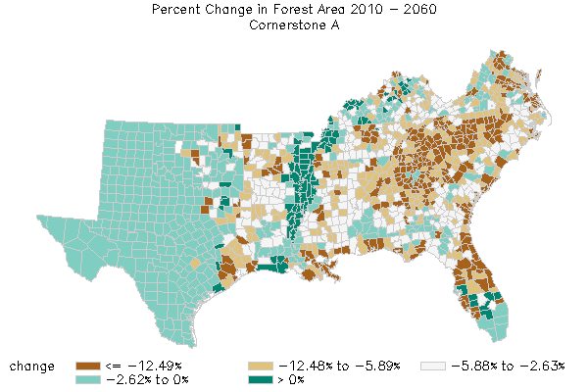
High Timber Prices

Slide 14
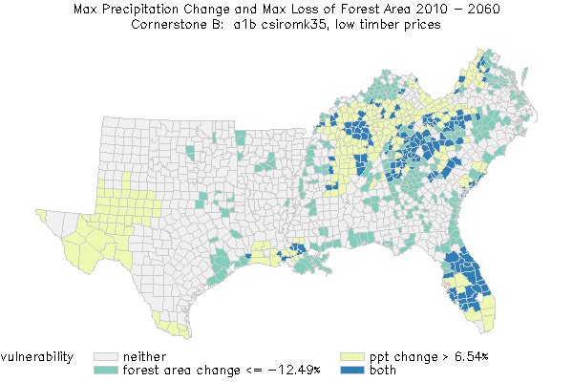

Slide 15
Why these data?
Builds on the RPA Assessment data base
Builds on the Futures Project
Provides a rationale description of alternative futures

Slide 16
Common Definitions and Conceptual Framework
Vulnerability: The susceptibility of an ecosystem to a stress or disturbance that invokes an undesirable change in structure or function. The most vulnerable ecosystems have low resilience.
• Vulnerability under current climate
• Vulnerability under future climate and current management
• Vulnerability under future climate and adaptive CC management
Risk: The functional relationship between the consequences of ecological or economic outcomes and their relative frequency.
Mitigation: Activities taken to reduce the severity of potential climate change, such as sequestering carbon.
Adaptation: Actions taken to decrease the undesirable impacts of climate change, or that increase the positive impacts.
Resilience: the magnitude of disturbance that can be absorbed before the system changes the structure, variables, and processes that control system behavior (also referred to as ecological resilience)

Slide 17
Can forest management be designed to enhance the sustainability of southern forest ecosystems and their values under climate change?

Slide 18
How are we doing this?
data
models
synthesis
expert knowledge
case study examples….

Slide 19
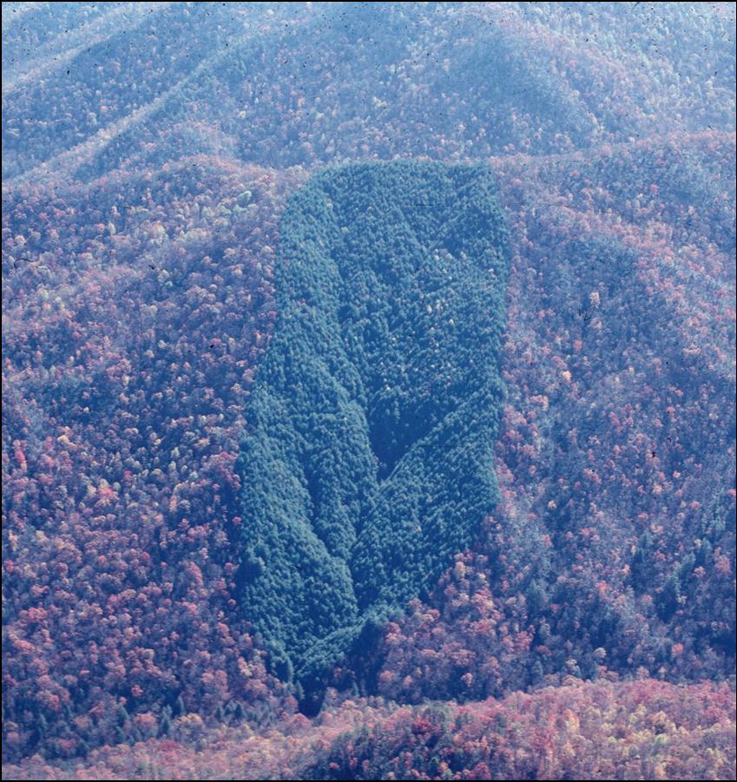
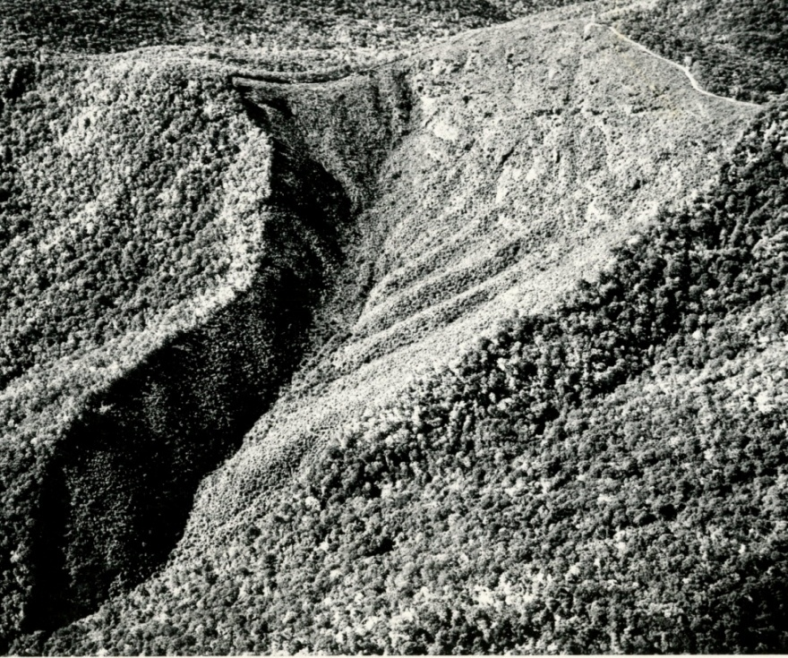
Long-term data from experimental watersheds can be used to examine
Interactions between climate change and forest management options…
temperature
precipitation

Slide 20
In the Appalachian-Cumberland eco-region, management actions can mitigate or exacerbate climate change impacts on water quantity
Applied models based on
historical data to future
climate (dry and wet)
scenarios
Pattern of response
comparable to retrospective
analyses.
Ford et al. (accepted in Ecol. App.)

Slide 21
Management actions can mitigate or exacerbate climate change impacts on water quantity
We used the results to develop a table of expected interactions between
management activities and extreme precipitation events.
For example, streamflow from pine stands is much lower than hardwood stands
during wet years.
 | Drought |  | Precipitation Excess
 | Exacerbates | Mitigates | Exacerbates | Mitigates
Spp. conversion
High-elevation clear cut
Low-elevation clear cut
Coppice
Old-field succession

Slide 22
 | Water | Carbon | Species | Fiber & Timber | Recreation | Fire | I&D | Invas
Increase Pine | - | + | - | + | - | - | - | -
Lengthen Rotations | + | - | + | - | + | + | - | +
Increase Biofuels | - | + | - | + | - | + | - | -
Change Roads | + | 0 | + | - | + | - | 0 | +
Increase Long-leaf | +
Increase Prescribed fire | 0
??????? | ?

Slide 23
Outline for CCAMMO Chapters
Use Future “Cornerstone Scenarios” as estimate of climate, forest cover, and human population projections.
Supplement with ensemble GCM.
2010 to 2060 – 50 years
Characterize vulnerability
Vulnerable = “threat” increases
“value” decreases
Where are social and biological systems most vulnerable?
Now - vulnerability under current climatic conditions
In the future - vulnerability under future climatic projections
Characterize risk
Where are the consequences of change greatest?
What management options/activities could be implemented to reduce vulnerability?
Use common resilience definition
“managing to increase resilience to climate change”
…so they can adapt to change
…so they can help mitigate change (C sequestration)
Overall concepts to be addressed
What do we already know about effects of climate on threat/value?
How have we managed in the face of disturbance climatic variation before?
What can this tell us about how to manage in the future?
What can we do now?
What can/should we do in 10, 20,…50 years?
Where should we implement management practices first (tie-in to risk)?
Case studies to provide specific “stand level” examples
Characterize vulnerability in the future with “CC Management”
Uncertainty/Confidence/Consequences

Slide 24
Use Future “Cornerstone Scenarios” as estimate of climate, forest cover, and human population projections.
Supplement with “ensemble” GCMs
2010 to 2060 – 50 years

Slide 25
Characterize vulnerability
Vulnerable = “threat” increases
“value” decreases
Where are social and biological systems most vulnerable?
now - vulnerability under current climatic conditions
in the future - vulnerability under future climatic projections
Characterize risk
Where are the consequences of change greatest?

Slide 26
What management options/activities could be implemented to reduce vulnerability?
Use common resilience definition
“managing to increase resilience to climate change”
…so they can adapt to change
…so they can help mitigate change (C sequestration)
Overall concepts to be addressed
What do we already know about effects of climate on threat/value?
How have we managed in the face of disturbance & climatic variation before?
What can this tell us about how to manage in the future?
What can we do now?
What can/should we do in 10, 20,…50 years?
Where should we implement management practices first (…tie-in to risk)?
Case studies to provide specific “stand level” examples
Characterize vulnerability in the future with “CC Management”

Slide 27
Vulnerability to current climate = VCC
Vulnerability to future climate = VFC
Vulnerability to future climate with CC management = VFCCCM
If VCC = or > than VFC, then no CC management needed
If VCC < VFC, then CC management needed
If VFC > VFCCCM, then CC management effective

Slide 28
Timeline
August/September 2011 – presentation of “near final” chapters (VTC)
October 2011 – final chapters submitted for peer review
January 2012 – distribute with science delivery tools (TACCIMO, workshops, etc…)

